Slide 1

AI-POWERED SMART WALKING STICK FOR THE VISUALLY IMPARED.
Supervisor Research Scholar
Dr. C.Anitha Jayaharini.J
Professor 192371034
Institute of Institute of
Saveetha School of Engineering Saveetha School of Engineering
MONITORING & ASSISTANCE MODULE
Notes:
1
1

Slide 2
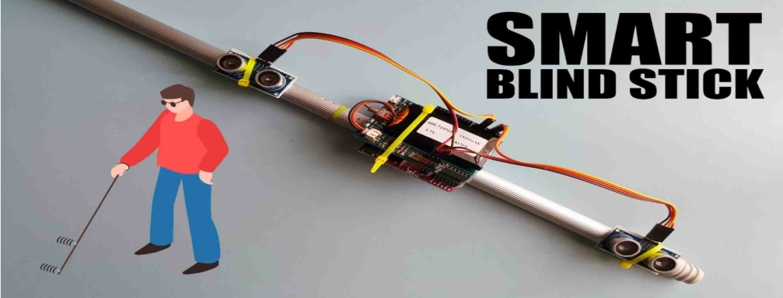
MONITORING
Monitors the real-time location of the user using a GPS module to ensure constant position awareness.
Sends SMS alerts via a GSM module with live location to registered emergency contacts or caregivers.
In emergencies like SOS button press, fall detection, or abnormal behavior, automatic alerts are triggered.
Supports geo-fencing to notify caregivers if the user moves out of a predefined safe zone (e.g., home).
GPS data is processed continuously in the background by a microcontroller, requiring no manual input.
Supports data logging of movement history to analyze user behavior and detect potential risks.
Increases user safety, promotes independent mobility, and provides peace of mind to families.

Slide 3
ASSISTANCE MODULE
Provides real-time obstacle detection using ultrasonic sensors and AI-based algorithms.
Alerts the user about nearby obstacles through vibration feedback or audio signals, based on their preference.
Delivers voice instructions via a speaker to guide the user safely in the right direction.
Helps identify both static and dynamic obstacles, such as walls, steps, poles, and moving people or vehicles.
Includes Text-to-Speech (TTS) functionality to announce warnings like “Obstacle ahead” or “Turn right.”
Supports low-battery and system alerts to keep the user informed about device status.
Requires no complex operation—designed to work automatically in real time with minimal user input.
Boosts the user’s confidence and independence, reducing their reliance on others for movement.
Complements the monitoring module by enhancing situational awareness and mobility safety.

Slide 4
REFERENCES
WalkVLM: Aid Visually Impaired People Walking by Vision Language Model (Dec 2024) Yuan et al. introduce a vision-language model that processes streaming video from cane-mounted cameras to generate clear, real-time reminders for obstacle avoidance.
MR.NAVI: Mixed‑Reality Navigation Assistant for the Visually Impaired (May 2025) Pfitzer et al. propose MR.NAVI, combining MobileNet object detection, depth estimation, and natural language feedback to identify obstacles and provide navigation cues including transit guidance.
AI‑Powered Walking Assistance System (ICETC 2024) This system uses YOLO and OAK-D Pro AI cameras to detect pedestrians and dynamically map walkable areas—mirroring human movement to guide users.
Embedded YOLOv5 Obstacle Detection for Indoor Navigation (2023)Describes use of YOLOv5 on embedded hardware for obstacle detection

